Slide 1


Slide 2
REST has arrived for ConfigMgr!
Notes:
“That’s right, you can now connect to ConfigMgr using REST natively! Join Greg in this session and learn how to configure the Administration Service, retrieve data and build automation.
We’ll also discuss limitations, workarounds, and automation scenarios to help make your job easier.”

Slide 3

Greg Ramsey
Senior Architect, Dell Technologies
Microsoft MVP, Enterprise Mobility
ramseyg@Hotmail.com
@ramseyg

Slide 4
Agenda
Github!
What?
Why?
Configure!
Uses & Demos!

Slide 5
What?

Slide 6
What is the ConfigMgr Admin Service?
The future….Seriously.
THE Web service to integrate with ConfigMgr….
…. from on-premise AND from the Internet

Slide 7
Accessing ConfigMgr
(The way we’ve done it for decades…)
Your Data Center
Admin Console
Trouble-shooting
Reporting
Svc Desk
ConfigMgr
Provisioning
SMS Provider (WMI)
Notes:
Constraining wmi to a fixed port (big question as to what this breaks)
https://docs.microsoft.com/en-us/windows/win32/wmisdk/setting-up-a-fixed-port-for-wmi?redirectedfrom=MSDN

Slide 8
Choose a new adventure….
ConfigMgr
Automated/External Processes
Reporting
Admin Service
ODATA
Admin Console
SQL
SMS Provider
WMI
Odata: https://<providerFQDN>/AdminService/v1.0/
WMI: https://<providerFQDN>/AdminService/wmi/
Admin Service URLS:

Slide 9
PowerBI
Azure
CMG
Admin SVC
Service Mgmt
Your Data Center
CM

Slide 10
Why? (why should I care)

Slide 11
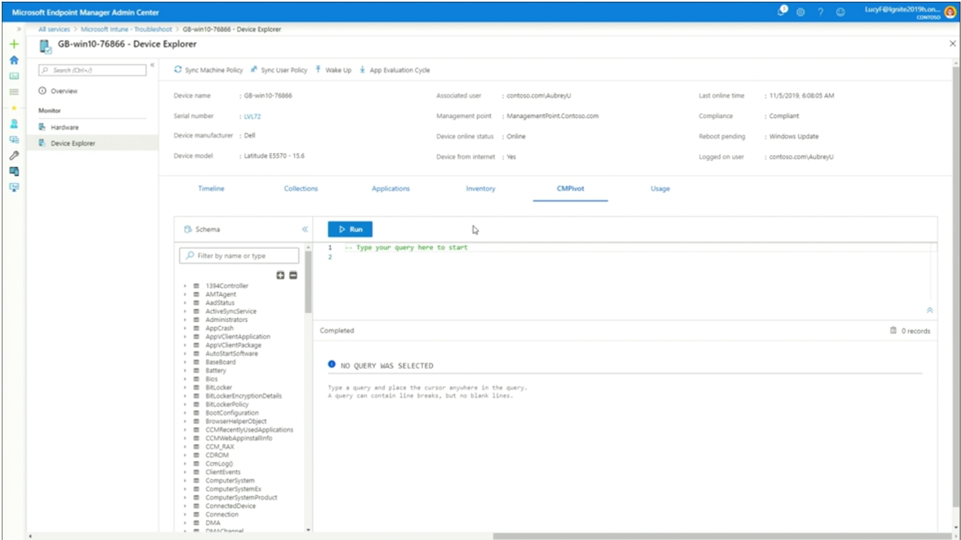

Slide 12
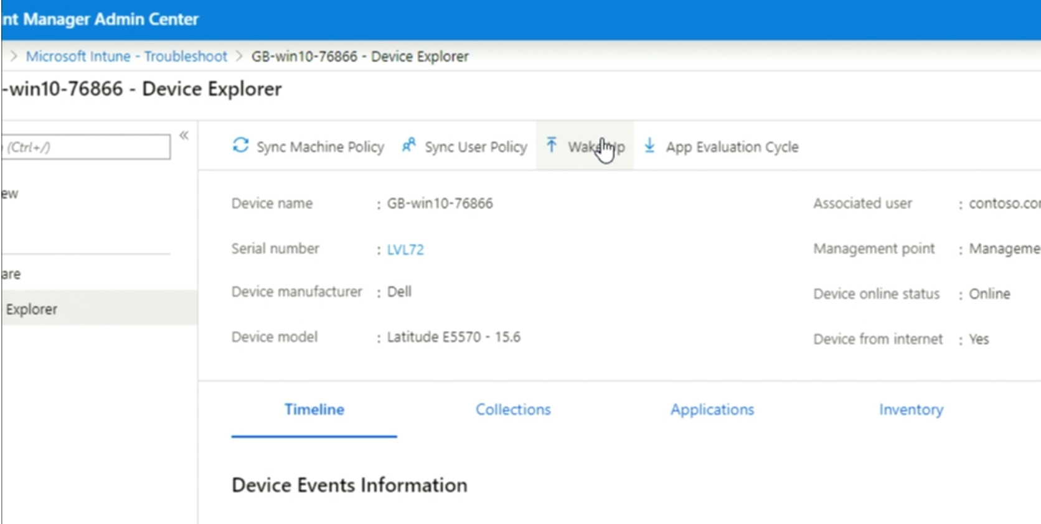

Slide 13
Configure!

Slide 14
Requirements
.NET 4.5 or later
ConfigMgr Current Branch 1902 or later https://servername/AdminService/wmi/SMS_Site
SSL Communication

Slide 15
Configuring AdminService
Default Config
Securing
Self-Signed Certs (Enhanced HTTPS) / PKI Certs
Credential Requirements
RBAC based
Use Domain or AAD Creds

Slide 16
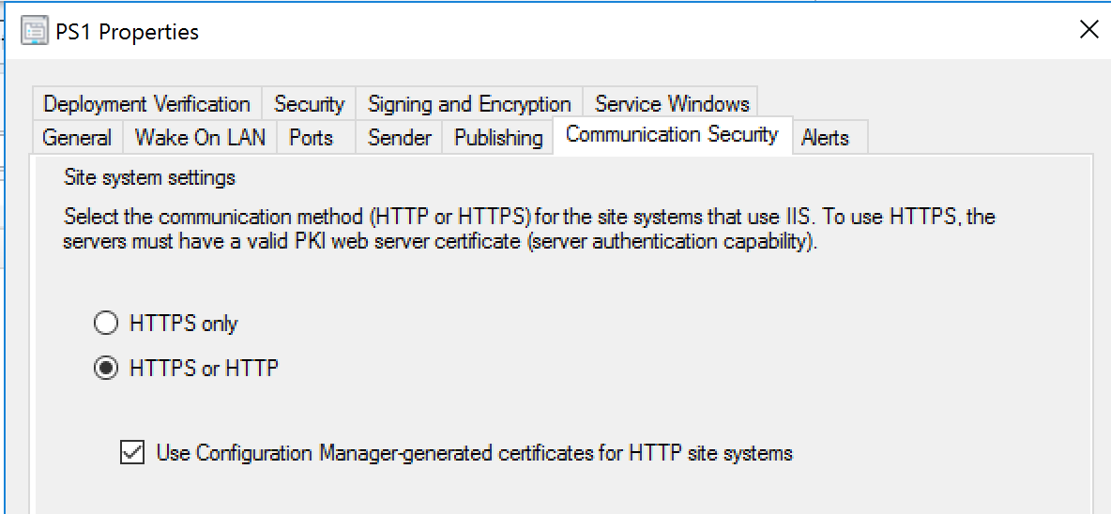
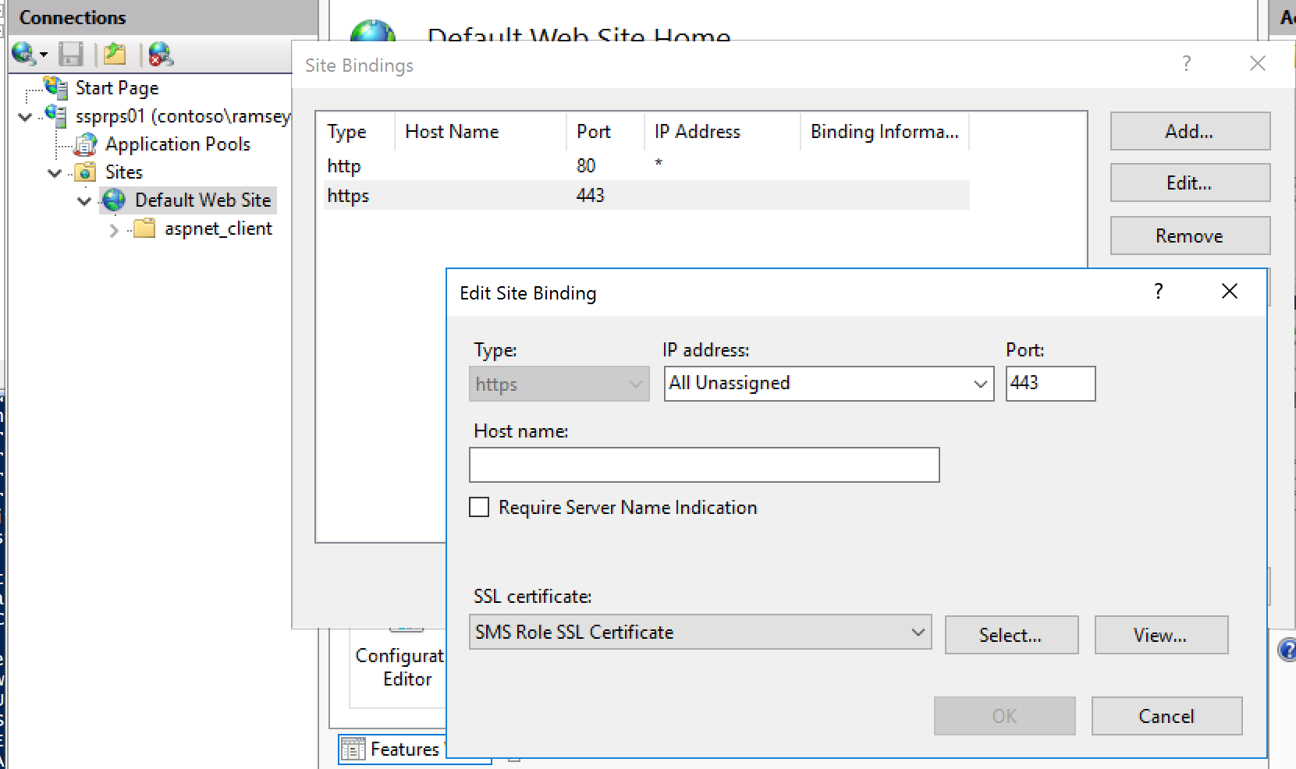
Enabling for On-Prem
Self-Signed CERT or PKI

Slide 17
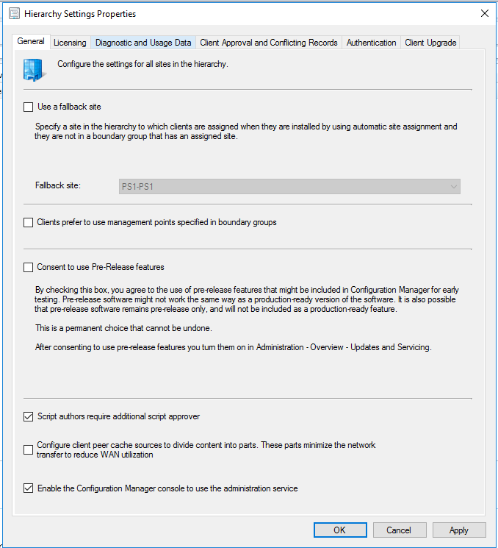

Slide 18
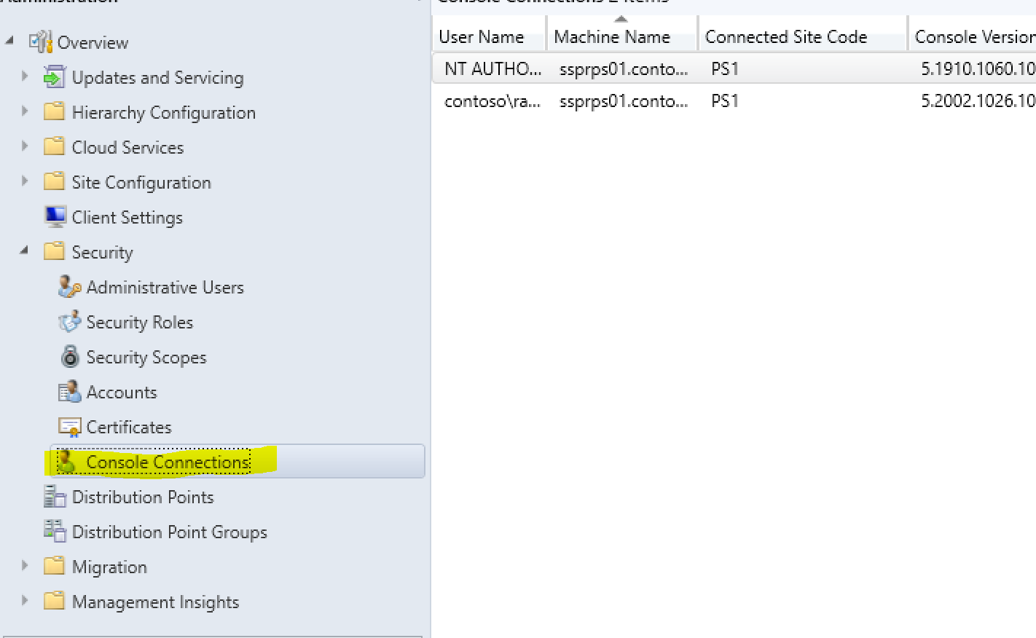
Test in admin console

Slide 19
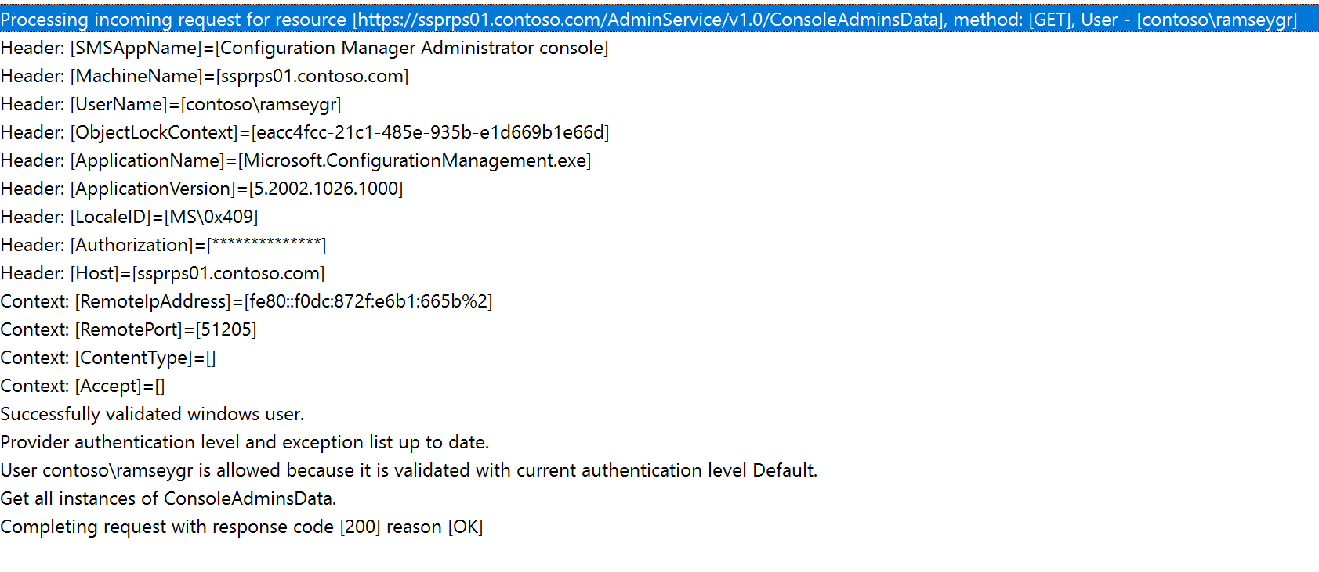
Test in admin console, verify in AdminService.log

Slide 20
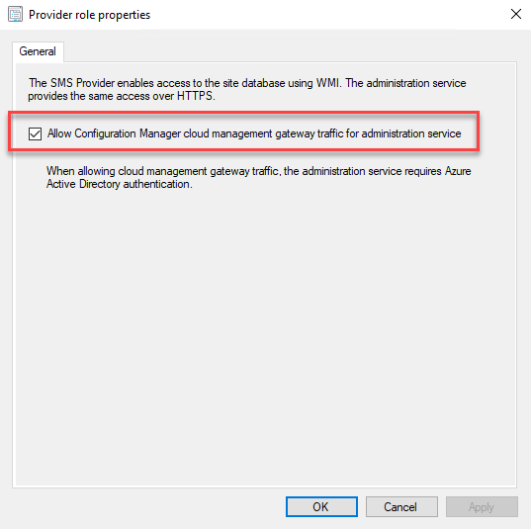
Enabling for CMG
SMS Provider – just a check box ☺
Peter van der Woude’s blog: Enabling the ConfigMgr administration service through the cloud management gateway

Slide 21
Logs!

Slide 22
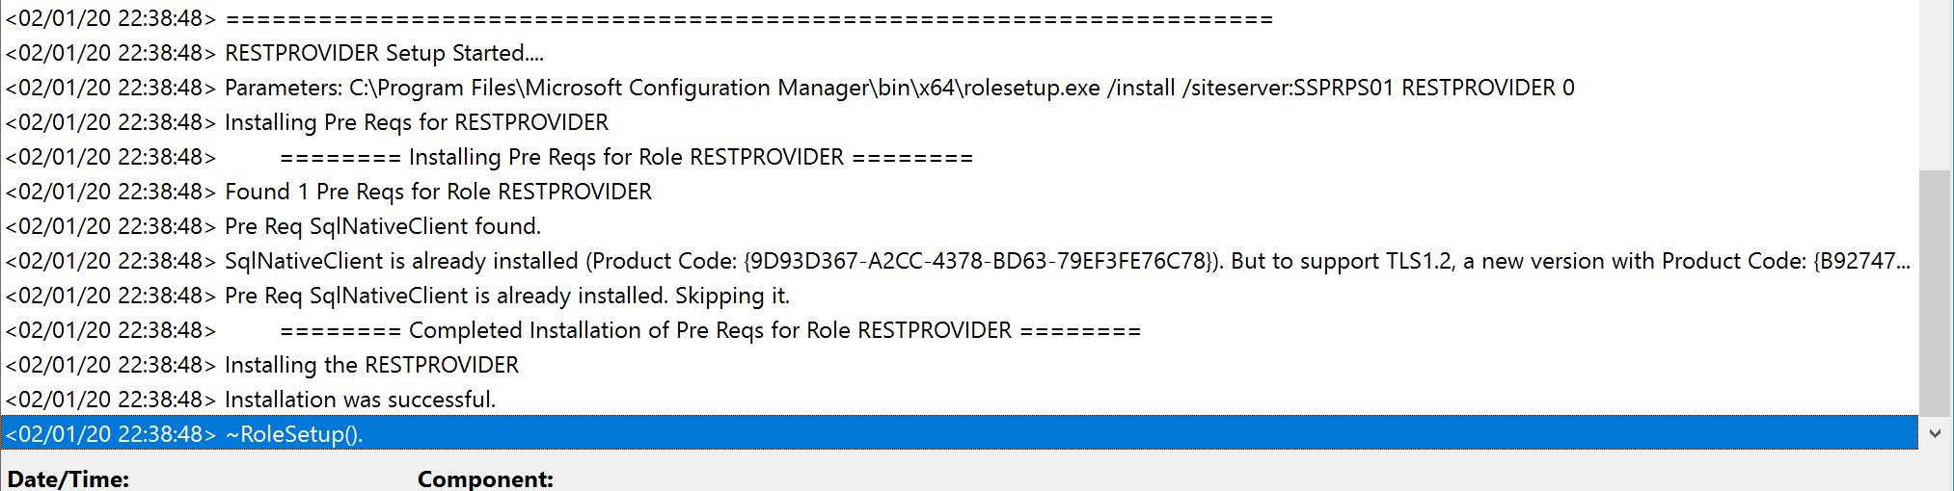
RESTPROVIDERSetup.log

Slide 23
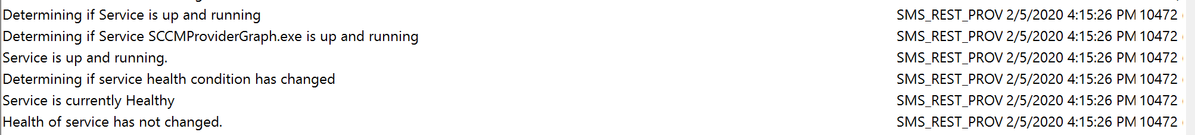
SMS_REST_PROVIDER.log

Slide 24
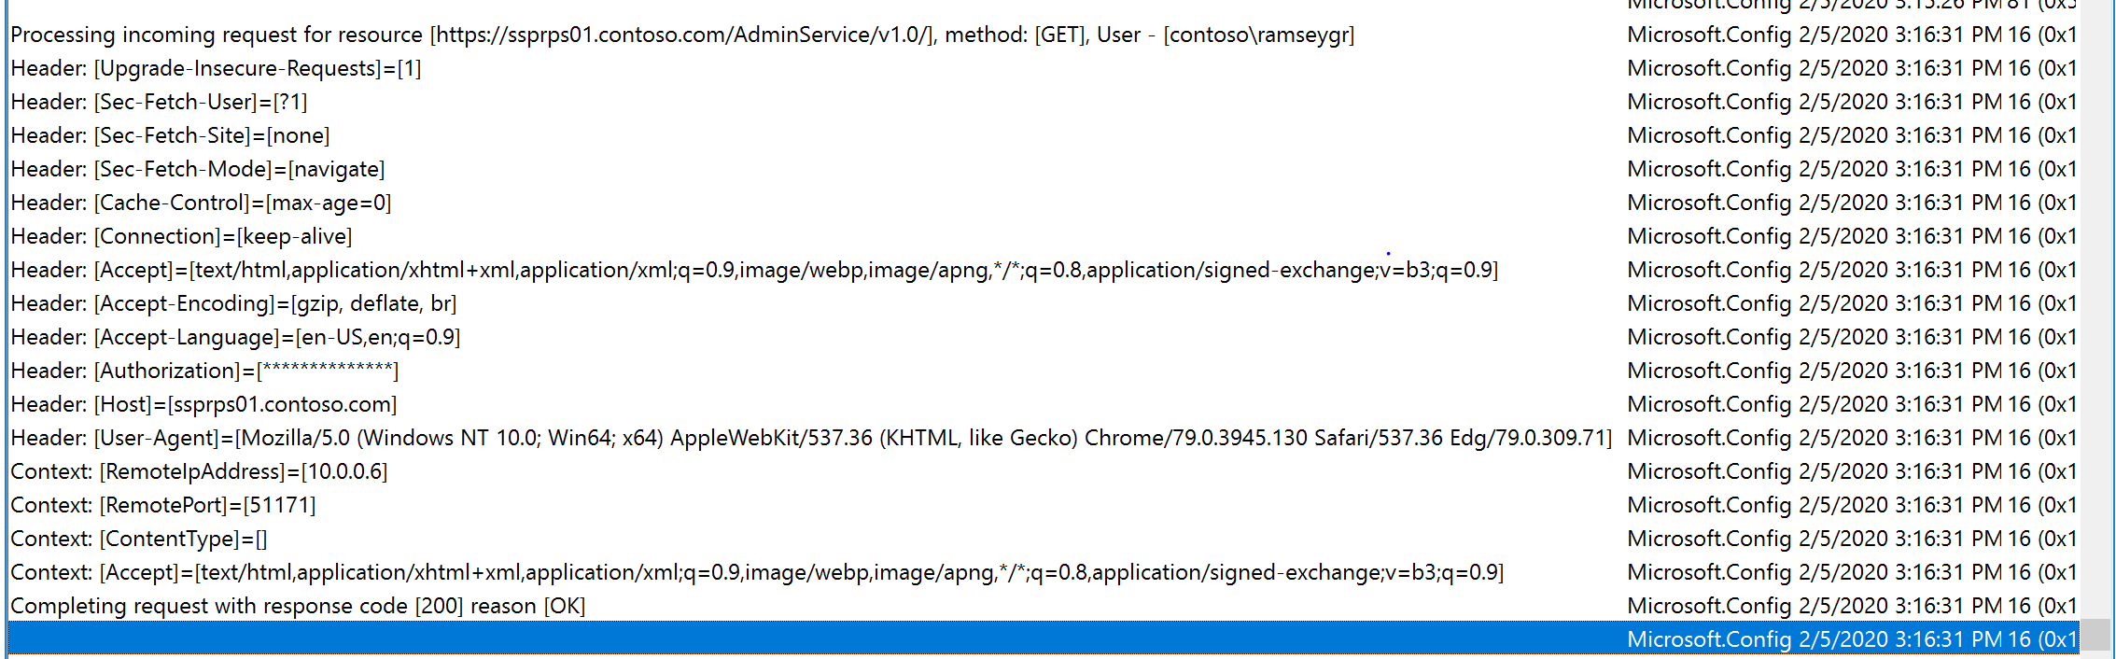
AdminService.log

Slide 25
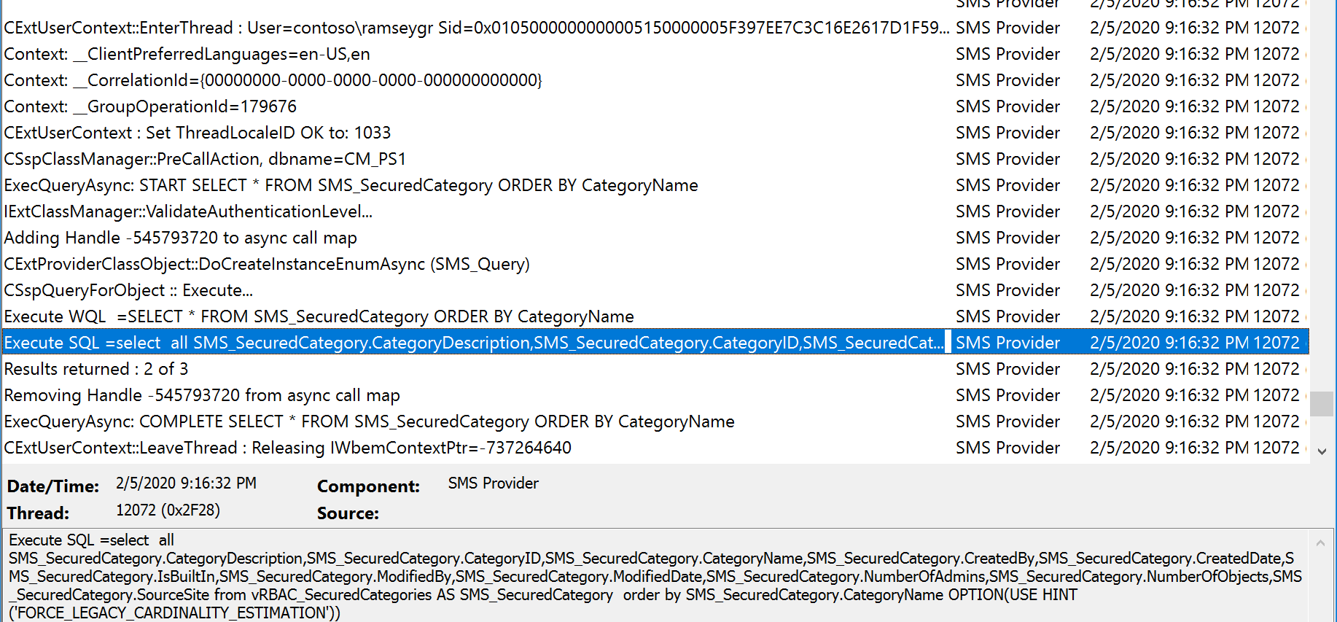
SMSProv.log

Slide 26
Demos!

Slide 27
Demos
Admin Console & Basics
Collection Details
Devices & Inventory
Object Management with PowerShell
Trigger Actions with PowerShell!

Slide 28
Links
Blogs
Adam Gross
Zeng (Sandy) Yinghua
Nathan Ziehnert
Steve Rachui
MEM Console, what’s coming, etc:
BRK008 – Modern management: How/why you do it now
BRK2082 – What’s new in Microsoft Endpoint Manager, including Microsoft Intune and Configuration Manager (Part 1 of 2)
BRK3220 – What’s new in Microsoft Endpoint Manager, including Microsoft Intune and Configuration Manager (Part 2 of 2)

Slide 29
Slides and demos from the conference will be available at
https://github.com/nordicinfrastructureconference/2020

